Slide 1



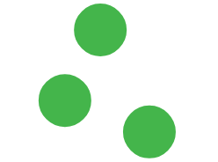



Support Vector Machines & K-Nearest Neighbors
Machine Learning Fundamentals
Eng. Ahmed Métwalli
Assistant Lecturer (Complementary Lecture)
Lecture 6
Topics
Classification Algorithms
SVM & KNN

Slide 2




Quick Overview
SVM
KNN
Support Vector Machine
K-Nearest Neighbor
Find the best separator line
Learn from neighbors

Slide 3
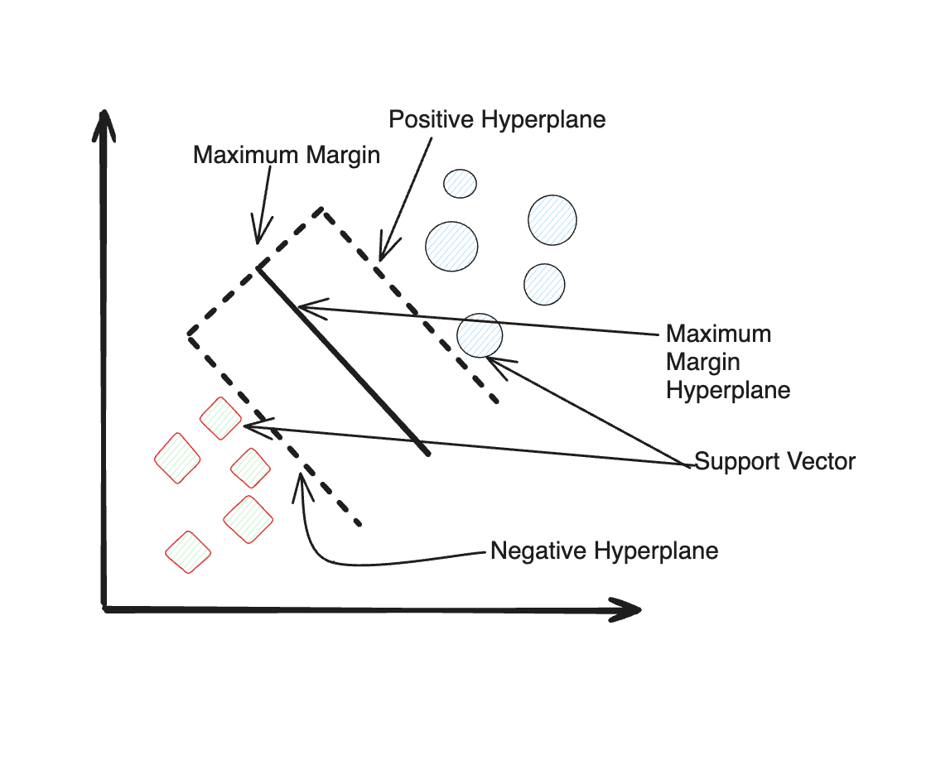


What is SVM?
Support Vector Machine
Find the Best Dividing Line
Maximize the Margin
Create the widest possible gap between classes
Separate Classes
Find optimal hyperplane for classification
MAXIMUM MARGIN

Slide 4
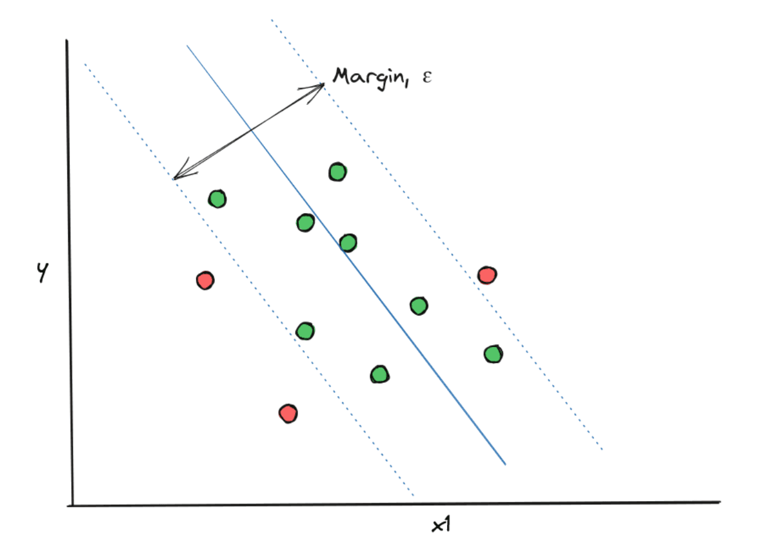



How SVM Works
The two margin boundaries are:
$$w^{T}x+b=+1$$
$$w^{T}x+b=−1$$
Blue Points: 10
MAX MARGIN
Red Points: 10
Best Line Maximizes Distance
Widest possible separation
Margin Width
3.2 units
MAXIMIZED

Slide 5




SVM Equations
Optimization Objective
Numerical Example
min (1/2)||w||²
Given Parameters:
subject to: yᵢ(w·xᵢ + b) ≥ 1
w = [2, 1]
b = -3
x = [4, 2]
Decision Boundary
Calculation:
w·x + b = 0
w·x + b = (2×4) + (1×2) - 3
Hyperplane separating classes
= 8 + 2 - 3
= 7
Margin Width
2/||w||
Decision Rule:
Distance between hyperplanes
Since 7 > 0
CLASS +1

Slide 6




Hard vs Soft Margin
HARD MARGIN
SOFT MARGIN
Perfect Separation
Allow Some Errors
All points classified correctly
1-2 points can be misclassified
0 Errors Allowed
Penalty Parameter
Strict boundary requirements
C = 1.0
Outlier Handling
Outlier Handling
Not suitable for noisy data with outliers
Robust to outliers with penalty factor

Slide 7
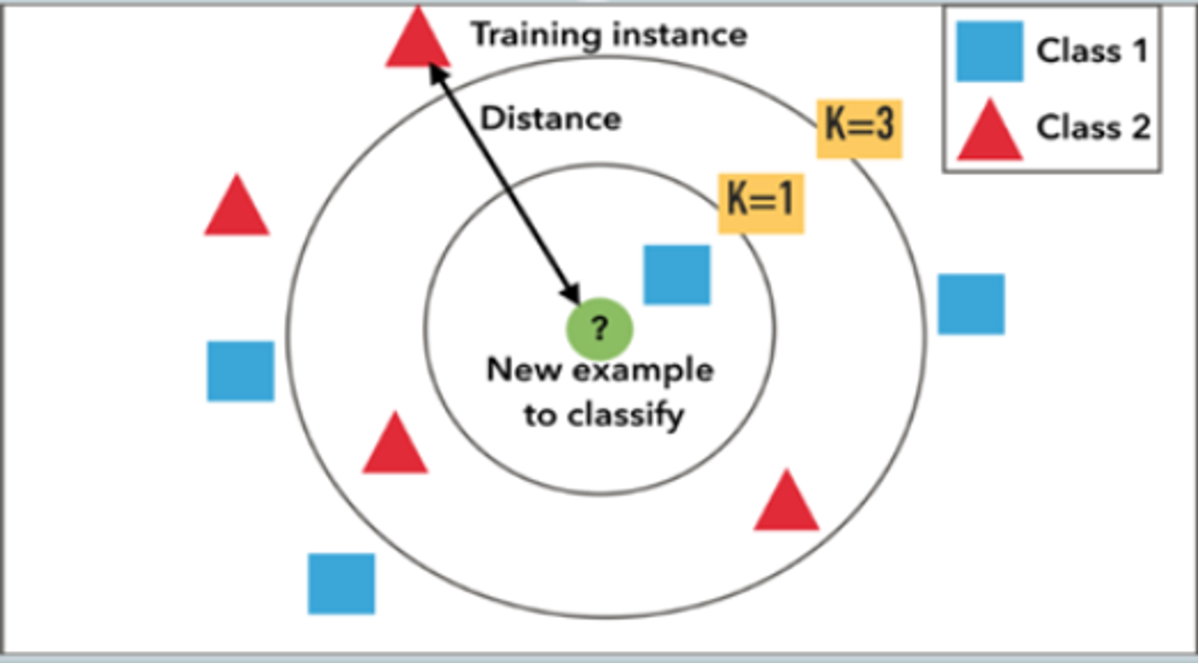



What is KNN?
K-Nearest Neighbor
Birds of a Feather Flock Together
Non-parametric
No assumptions about data distribution
Learn from Neighbors
Similarity drives classification
Simple & Intuitive
Pattern Recognition
Easy to understand and implement

Slide 8




How KNN Works
Calculate Distance
1
Choose K
2
Measure similarity using Euclidean or Manhattan
Select number of neighbors to consider
Vote or Average
3
Find K Neighbors
4
Majority vote for classification, average for regression
Identify the K closest data points

Slide 9

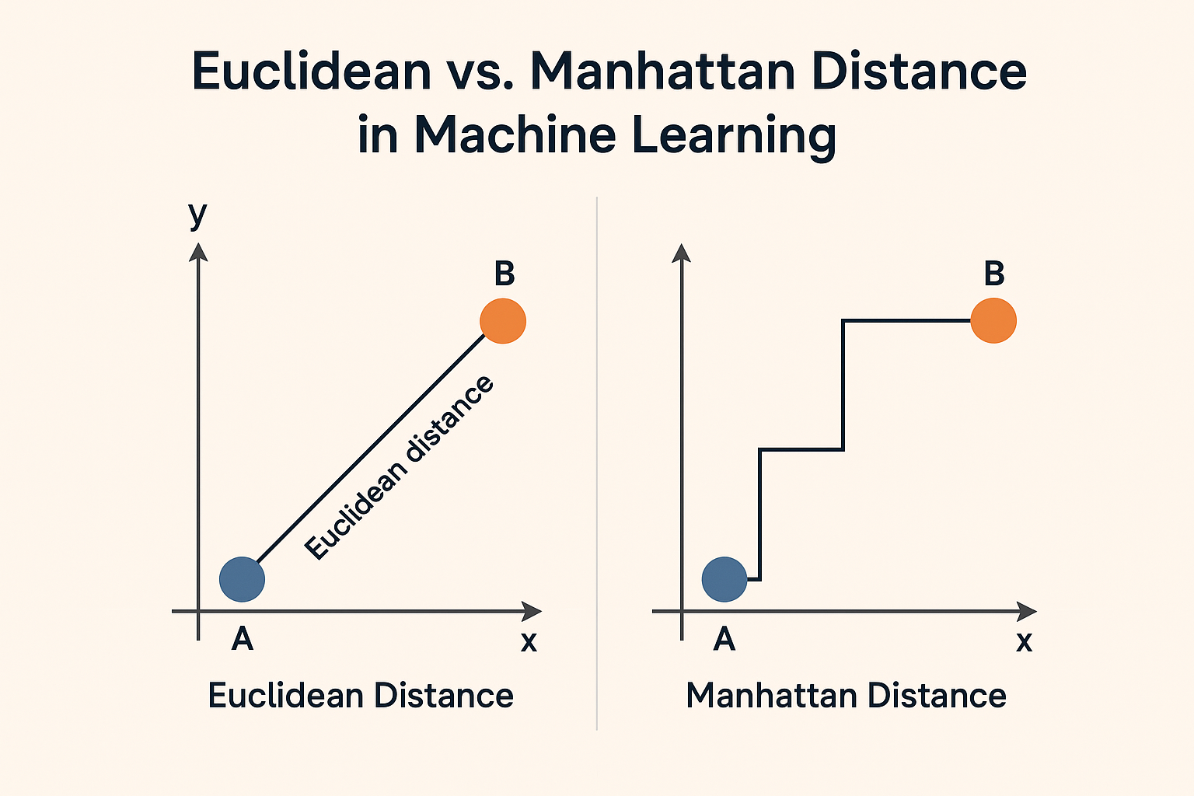

Distance Metrics
Euclidean
Straight line distance
Point A(3,4), B(6,8)
5.0
Distance =
units
Manhattan
Grid path distance
Point A(3,4), B(6,8)
7.0
Distance =
units

Slide 10


KNN Equations
Voting Example
Euclidean Distance
Given K = 3
d(x, y) = √[Σ(xᵢ - yᵢ)²]
RED
RED
BLUE
Neighbor 1
Neighbor 2
Neighbor 3
Manhattan Distance
d(x, y) = Σ|xᵢ - yᵢ|
Count Neighbors:
2
1
Voting Formula
RED
BLUE
ĉ(x) = mode{c₁, c₂, ..., cₖ}
where cᵢ = class labels of K neighbors
Mode =
{RED, RED, BLUE}
RED

Slide 11








Choosing K Value
K=1
K=5
K=15
Too Sensitive
Good Balance
Oversmooths
Overfits to noise
Robust to noise
Underfits data
High variance
Smooth boundaries
High bias
Unstable boundaries
Good generalization
Misses local patterns
Example Dataset
Selection Rules
100 Data Points
Odd Numbers + Cross-Validation

Slide 12



KNN in Action
Test Point
(5, 5)
VOTE
2
1
Point (4, 4)
1
RED
BLUE
1.41 [RED]
Point (6, 6)
PREDICTION
2
1.41 [RED]
RED
Point (4, 7)
3
2.24 [BLUE]

Slide 13













SVM vs KNN Comparison
SVM
KNN
Complex boundaries with maximum margin
Simple local pattern recognition
Faster prediction after training
Slower prediction (calculates distances)
Slower training process
No training needed
Best for high-dimensional data
Best for low-dimensional data
When to Use Each
SVM: Large datasets, high dimensions, need robust boundaries
KNN: Small to medium datasets, low dimensions, interpretable results

Slide 14









Key Takeaways
SVM
KNN
Maximize the margin between classes
Learn from neighbors - similarity matters
Robust to outliers with soft margins
Adapts to patterns in local data
Best for complex boundaries and high dimensions
No training needed - instant implementation
Both Algorithms
SVM + KNN
Powerful Classification Tools • Choose Based on Data Complexity & Size

